Slide 1
The NYC Taxi CRISIS – Week V
Group 7
Haardik Sharma
Harsha Chandar
Madhukiran M
Yogesh Reddy

Slide 2

Problem statement
Does Uber serve unmet demand or compete with NYC yellow taxis in New York?

Slide 3
Problem Statement Continued
Pure Competition
Unmet Demand Serving
Partial Competition – Partial Demand Serving

Slide 4
Problem Statement Continued
If out of a total of 1,000,000 rides, the NYC taxis are serving 800,000 rides, and Uber is serving 200,000 rides, there could be three possibilities:
(a) If Uber was not there, NYC taxis might have served 1 million rides. In this case, Uber is fully competing with NYC Taxis for customers.
(b) If Uber was not there, NYC taxis still serve 800,000 rides. In this case, Uber is said to serve unmet demand.
(c) If Uber was not there, NYC taxis might have served 950,000 rides. In this case, Uber is partially serving unmet demand (50,000 rides) and partially competing with NYC Taxis (150,000 rides).
Estimate the extent to which Uber is competing with NYC Taxis ?

Slide 5
THE DATA – APRIL 2014
NYC TAXI:
PICKUP TIMESTAMP| DROPOFF TIMESTAMP | PICKUP LONGITUDE|PICKUP LATITUDE| DROPOFF LONGITUDE|DROPOFF LATITUDE
UBER:
PICKUP TIMESTAMP| PICKUP LONGITUDE|PICKUP LATITUDE |BASECODE
DERIVED COLUMNS:
> DISTANCE – Distance of the pickup/dropoff coordinates from the point of interest
> TIMEBUCKETS – To bin the timestamp with a 5 minute interval

Slide 6
Analysis Approach
Selected 5 locations in the New York Region:
Considered a good mix of High-foot fall locations, Tourist spots and Transport hubs.
Rockefeller Center
Times Square
World Trade Center
Grand Central
Port Authority
Found out the number of Uber VS NYC Taxi Pickups for these location.

Slide 7
Analysis Approach Continued
Calculated the number of pickups happening around the 100 meter radius of our locations of interest.
This was done by:
Bucketing the Pickup Distances
Bucketing the Time Window

Slide 8
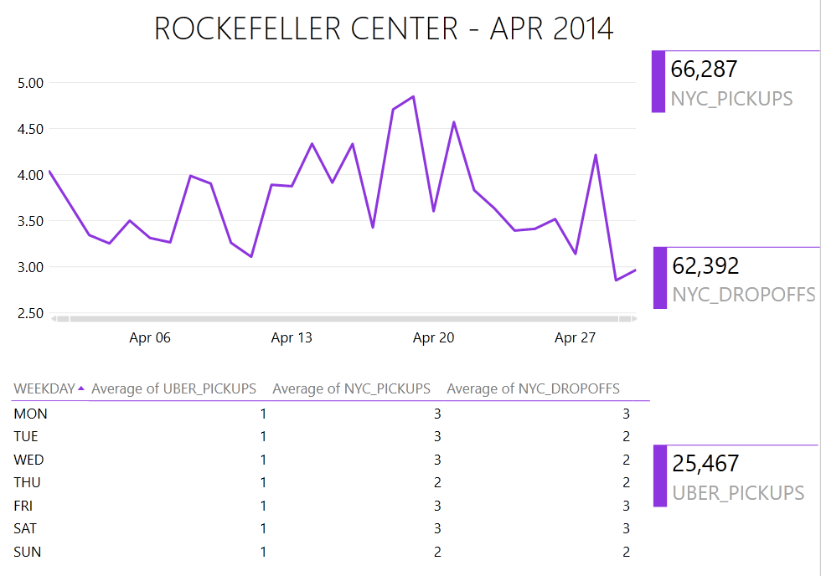
The Average Demand was around 3 to 4 taxis at every 5 minute interval
There was a constant demand for taxis across all days of the week

Slide 9
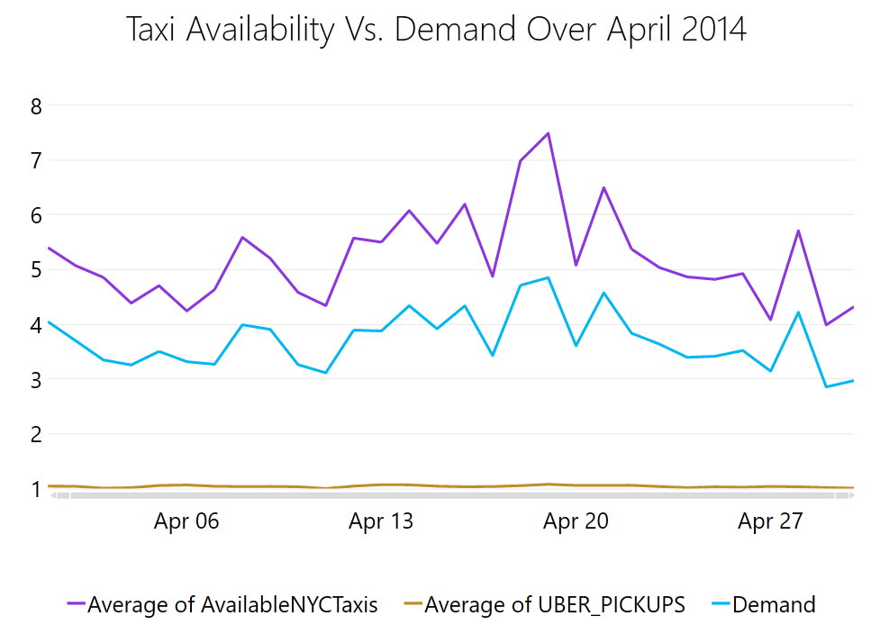
NYC Taxi availability was consistently above demand

Slide 10
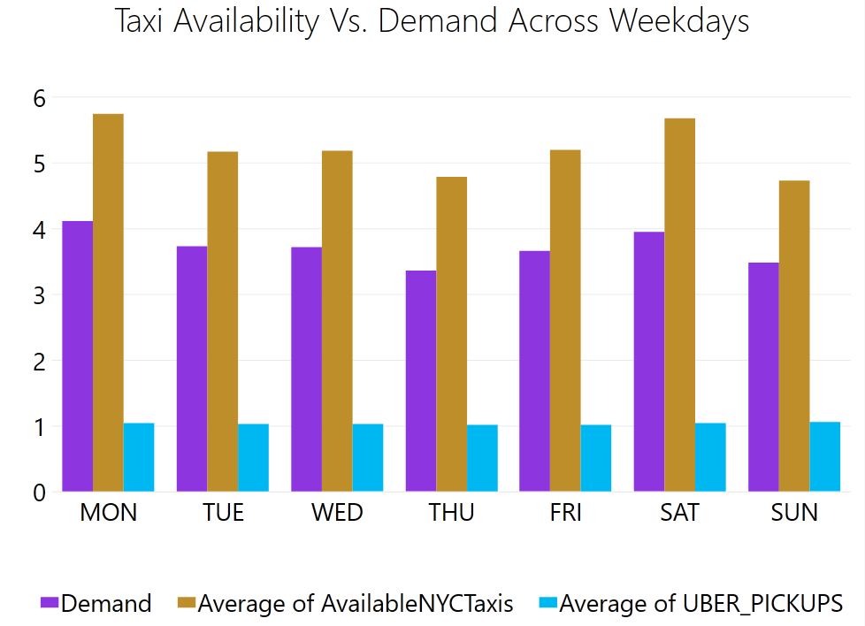
The trend was similar across different days of the week

Slide 11
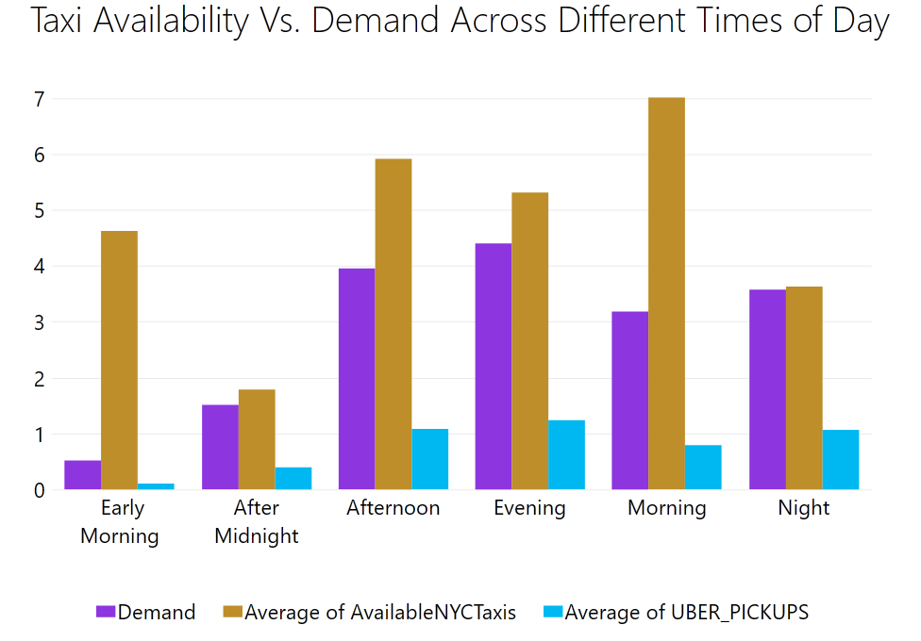

Slide 12
Next Steps
Scale up the Analysis for other locations.
Increase the Time Period under consideration.

